Slide 1
Additional Material
Crowd Management: Risk, security and health

Slide 2
Managing Security; a risk Based Approach
Jason L. Brown
National Security Director - Thales Australia and New Zealand
Chair ISO Technical Committee 262 Risk Management
Convenor ISO28000 Supply Chain Security
Chair Australian Standards MB25 Security and Resilience

Slide 3
Definitions of Security
Security as an outcome
The state of being free from danger or threat: Oxford Dictionary
The state of feeling safe, stable, and free from fear or anxiety: Oxford Dictionary
The quality or state of being secure: as
a : freedom from danger : safety
b : freedom from fear or anxiety
  Merriam-Webster
Security as a process
Procedures followed or measures taken to ensure the security of a state or organization: Oxford Dictionary
a : something that secures : protection
b (1) : measures taken to guard against espionage or sabotage, crime, attack, or escape (2) : an organization or department whose task is security
  Merriam-Webster

Slide 4
Protective Security is the principles, framework, processes and actions implemented to respond to and reduce the risk of harm from malicious acts.
  (Malicious acts are those where there is the intention and capability to do harm).

Slide 5
First there is the word, risk.
The common usage of the word “risk” shows how the concept is multifaceted. Industrial risk, climatic risk, risk capital, high risk sports, risky business, are uses which can consider events which can be controlled, others which cannot, where loss and gain are associated, an activity which stimulates humans and so on. Such diversity is in the history of the word, intertwined with ancient concepts as danger and chance, along with the idea of voluntary (human control) and involuntary (outside human control) action underlying many of the interpretations of risk.
The concept risk can be found in human anticipation for an uncertain future, resolving problems, making decisions and determining actions and the overall developing of a better understanding of the world in which we live and the limits to this understanding.

Slide 6

In an episode of Star Trek Voyager dealing with trans temporal issues, the First Officer of the USS Relativity (a ship from Voyager’s possible future guarding the timelines) says to the captain, who is demanding a risk-free solution, “uncertainty is part of the equation”. It makes the point that no decision is able to be made without consideration of the elements affecting the judgement and the potential effect on and consequential outcome for your objectives, positive or negative, and therefore potential consequences cannot be completely known. The more complex the system in which you operate the more likely that you will have unknowns that will impact on your decisions and therefore on your objectives.

Slide 7
TC 262 Risk Management
Risk – the effect of uncertainty on objectives
You take or accept a risk in order to achieve an objective (outcome, goal or mission)
You accept a risk when you believe that, on the balance of likelihood, you will be successful.

Slide 8
Security Architecture
GOVERNANCE
RISK MANAGEMENT
BUSINESS OPERATIONs
PROTECTIVE SECURITY
Physical
CONVERGENCE
INTERGRATION
PROTECTION
Personnel
Information
Cyber

Slide 9
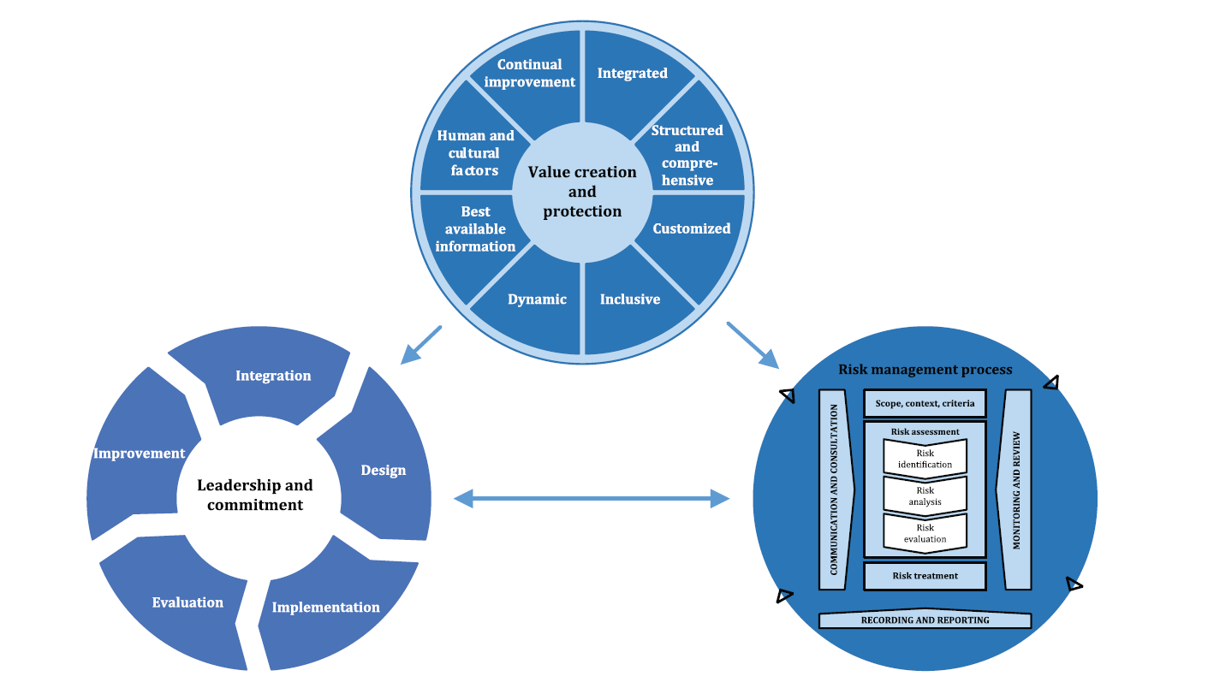
ISO 31000:2018

Slide 10
Managing risk is based on the principles, framework and process outlined in this presentation, as illustrated. These components might already exist in full or in part within the organization; however, they might need to be adapted or improved so that managing risk is efficient, effective and consistent.
Notes:
informed decisions.
Managing risk is part of governance and leadership, and is fundamental to how the organization is managed at all levels. It contributes to the improvement of management systems.
Managing risk is part of all activities associated with an organization and includes interaction with stakeholders.
Managing risk considers the external and internal context of the organization, including human behaviour and cultural factors.
Managing risk is based on the principles, framework and process outlined in this document, as illustrated in Figure 1. These components might already exist in full or in part within the organization, however, they might need to be adapted or improved so that managing risk is efficient, effective and consistent.

Slide 11
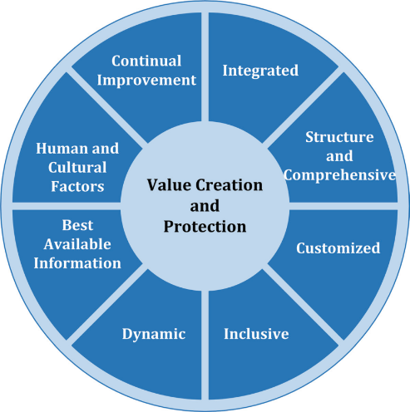
f) Best available information
The inputs to risk management are based on historical and current information, as well as on future expectations. Risk management explicitly takes into account any limitations and uncertainties associated with such information and expectations. Information should be timely, clear and available to relevant stakeholders.
g) Human and cultural factors
  Human behaviour and culture significantly influence all aspects of risk management at each level and stage.
h) Continual improvement
  Risk management is continually improved through learning and experience.

Slide 12
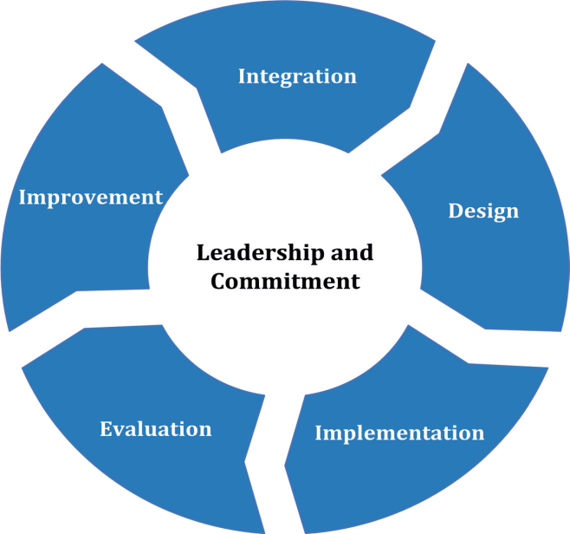
The purpose of the risk management framework is to assist the organization in integrating risk management into significant activities and functions. The effectiveness of risk management will depend on its integration into the governance of the organization, including decision-making. This requires support from stakeholders, particularly top management.

Slide 13
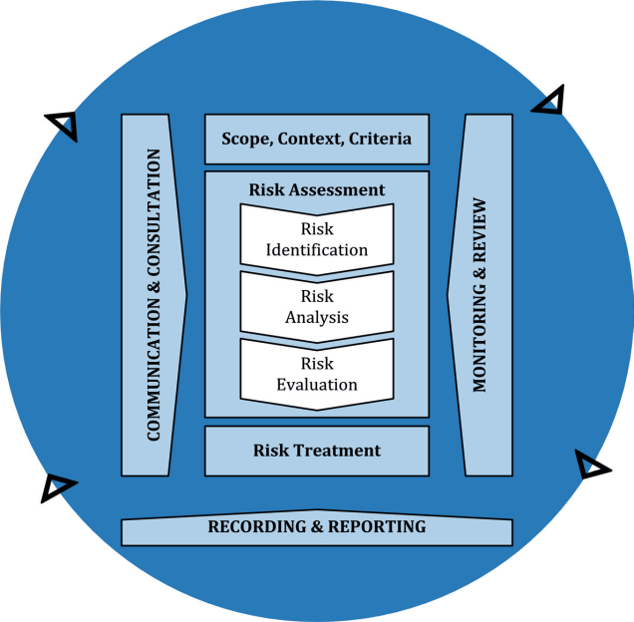
The risk management process should be an integral part of management and decision-making and integrated into the structure, operations and processes of the organization. It can be applied at strategic, operational, programme or project levels.
There can be many applications of the risk management process within an organization, customized to achieve objectives and to suit the external and internal context in which they are applied.
The dynamic and variable nature of human behaviour and culture should be considered throughout the risk management process. Although the risk management process is often presented as sequential, in practice it is iterative.

Slide 14
Establish the Context
It is important to evaluate and understand the context of the organization:
  Defining the external and internal parameters to be taken into account when managing risk, and setting the scope and risk criteria for the risk management policy.
  Internal context - internal environment in which the organization seeks to achieve its objectives
  External context - external environment in which the organization seeks to achieve its objectives
  Risk management context – the risk criteria and terms of reference against which the significance of a risk is evaluated

Slide 15
Security Risk Management Process Management Elements
SCOPE
Security program to achieve Organisational Objectives
Governance, policy and processes
CONTEXT
Organisational operating environment
Organizational operations and management
Impact on stakeholders
CRITERIA
Determination of risk acceptance and tolerance
Communication & Consultation
Scope, Context, Criteria
Monitoring & Review
Risk Assessment
Communication & Consultation
Communications Strategy
Client and Stakeholder requirements
Privacy
Confidentiality
Consent
Sources of validation
Process guidance
Roles
Information access and use
Risk Identification
Monitoring & Review
Accountability
Responsibility
Consistency
Probity
Audit
Assurance
Policy and process review
Risk Analysis
Risk Evaluation
Risk Treatment
Recording & Reporting
Records Policy
Records management system
Access to documentation
Reporting Channels
Recording & Reporting

Slide 16
Security Risk Management Assessment and Treatment Process Elements
Communication & Consultation
Scope, Context, Criteria
Monitoring & Review
RISK ASSESSMENT
Risk Identification
Value and Criticality of Assets
Proposed level of access and authority
Current Vulnerability and Sources of Threat
Risk Analysis
Impact analysis of loss or damage
Level of certainty
Volatility – rate of changes in variables
Risk Identification
Potential for
  loss or damage of assets
  Product quality loss
  Damage to reputation
  Impact on clients/customers
  Los of competitiveness
Risk Assessment
Risk Identification
Risk Analysis
Risk Identification
RISK TREATMENT
Specific selection criteria
Physical Security Controls
Personal Security Controls
Information Management Controls
Work History and performance
Cyber Controls
Review and Improvement Processes
Risk Treatment
Recording and Reporting

Slide 17
Taxonomy of risk
Uncertainty
Likelihood
Vulnerability
Threat/Hazard
Volatility
Variation
Effect
Consequences
Objectives

Slide 18
Risk = consequence x threat
Estimate with high certainty
Estimate with high uncertainty
Note the slash through; Why? – this model is often repeated in risk plans and descriptions but is intrinsically incorrect. You can not multiple an apple by an uncertain number of grapes and expect wine or cider!

Slide 19
Likelihood of Threat being realised
Intent (Highly variable, qualitative)
Desire
Expectance
Capability (moderate to low variability, allows some quantitative analysis)
Knowledge
Resources

Slide 20
Risk ⊨ Uncertainty ʌ Context
Uncertainty and Context are interdependent on the level of knowledge or actions taken in respect to organisational Capacity or Vulnerability and their intersection with Opportunity or Threat/Hazard and consequences arising from how this intersection is managed (risk management)
Risk(likelihood)of harm ⊨ Vulnerability ʌ Threat/Hazard
Volatility is a function of Change over Time; V⊤ C/T
Uncertainty is dependent on Complexity & Volatility & Ambiguity of the relevant Context ; U ⊨ V ʌ C ʌ A

Slide 21
uncertainty
noun [ C or U ]
UK ​ /ʌnˈsɜː.t^{ə}n.ti/ US ​ /ʌnˈsɝː.t^{ə}n.ti/
​C1 a situation in which something is not known, or something that is not known or certain:
https://dictionary.cambridge.org/dictionary/english/uncertainty
UNCERTAINTY, DOUBT, DUBIETY, SKEPTICISM, SUSPICION, MISTRUST mean lack of sureness about someone or something. UNCERTAINTY may range from a falling short of certainty to an almost complete lack of conviction or knowledge especially about an outcome or result. assumed the role of manager without hesitation or uncertainty DOUBT suggests both uncertainty and inability to make a decision. plagued by doubts as to what to do DUBIETY stresses a wavering between conclusions. felt some dubiety about its practicality SKEPTICISM implies unwillingness to believe without conclusive evidence. an economic forecast greeted with skepticism ……….
https://www.merriam-webster.com/dictionary/uncertainty

Slide 22
Knightian uncertainty
  In economics, in 1921 Frank Knight distinguished uncertainty from risk with uncertainty being lack of knowledge which is immeasurable and impossible to calculate; this is now referred to as Knightian uncertainty:
Uncertainty must be taken in a sense radically distinct from the familiar notion of risk, from which it has never been properly separated.... The essential fact is that 'risk' means in some cases a quantity susceptible of measurement, while at other times it is something distinctly not of this character; and there are far-reaching and crucial differences in the bearings of the phenomena depending on which of the two is really present and operating.... It will appear that a measurable uncertainty, or 'risk' proper, as we shall use the term, is so far different from an unmeasurable one that it is not in effect an uncertainty at all.
— Frank Knight (1885–1972), Risk, Uncertainty, and Profit (1921), University of Chicago.^{[10]}
Other taxonomies of uncertainties and decisions include a broader sense of uncertainty and how it should be approached from an ethics perspective:^{[11]}
A taxonomy of uncertainty
There are some things that you know to be true, and others that you know to be false; yet, despite this extensive knowledge that you have, there remain many things whose truth or falsity is not known to you. We say that you are uncertain about them. You are uncertain, to varying degrees, about everything in the future; much of the past is hidden from you; and there is a lot of the present about which you do not have full information. Uncertainty is everywhere and you cannot escape from it.
Dennis Lindley, Understanding Uncertainty (2006)
https://en.wikipedia.org/wiki/Uncertainty

Slide 23
Known,
Known Unknown,
Unknown Unknown
In epistemology and decision theory, the term unknown unknown refers to circumstances or outcomes that were not conceived of by an observer at a given point in time. The meaning of the term becomes more clear when it is contrasted with the known unknown, which refers to circumstances or outcomes that are known to be possible, but it is unknown whether or not they will be realized. The term is used in project planning and decision analysis to explain that any model of the future can only be informed by information that is currently available to the observer and, as such, faces substantial limitations and unknown risk.

Slide 24
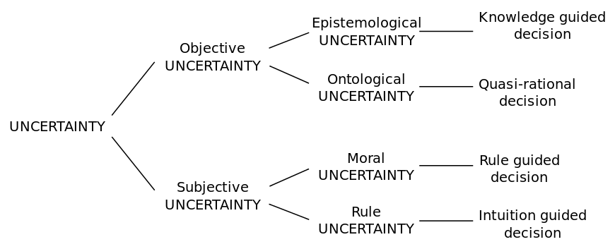
The uncertainty taxonomy proposed by Tannert et al. EMBO reports 8, 10, 892–896 (2007)

Slide 25
Exposure The state of having no protection from something harmful:
To calculate risk exposure, variables are determined to calculate the probability of the risk occurring. These are then multiplied by the total potential loss of the risk. To determine the variables, organizations must know the total loss in dollars that might occur, as well as a percentage depicting the probability of the risk occurring. The objective of the risk exposure calculation is to determine the overall level of risk that the organization can tolerate for the given situation, based on the benefits and costs involved. The level of risk an organization is prepared to accept is called its risk appetite.

Slide 26
Vulnerability
the intrinsic properties of something resulting in susceptibility to a risk source that can lead to an event with a consequence. [ISO/IEC Guide 73:2009]

Slide 27
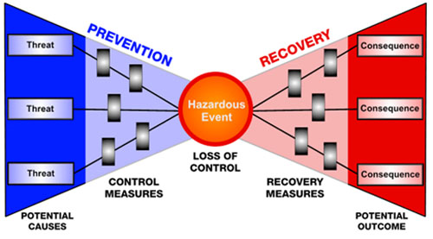
Event created by malicious actor
Monitor, Prepare, Prevent and Respond
Attack
Monitor, Plan, Attack and Defend

Slide 28
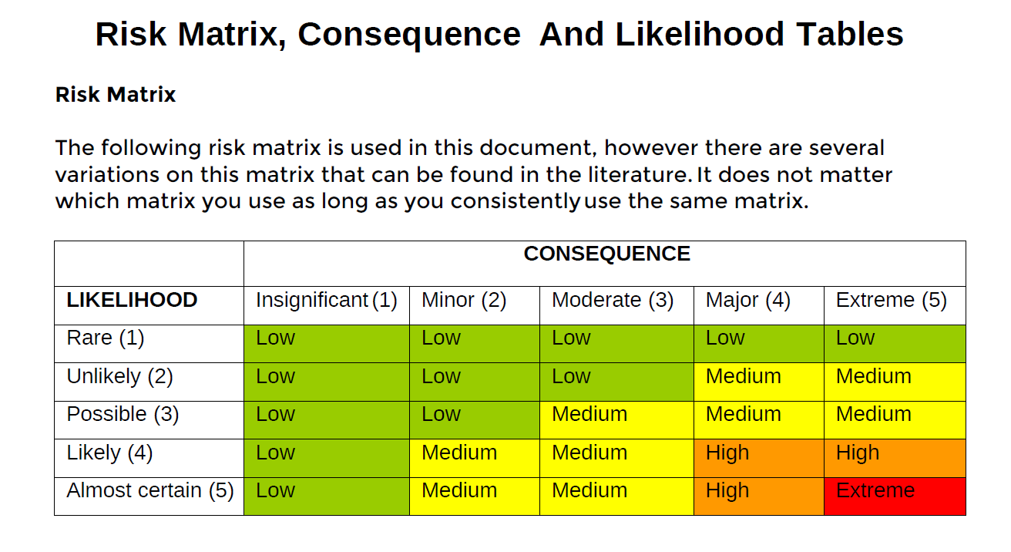
SRMBoK
While having some value to provide a snap shot multiplying the two factor is an incorrect use of a representative modelling but often done by inexperienced RM advisors

Slide 29
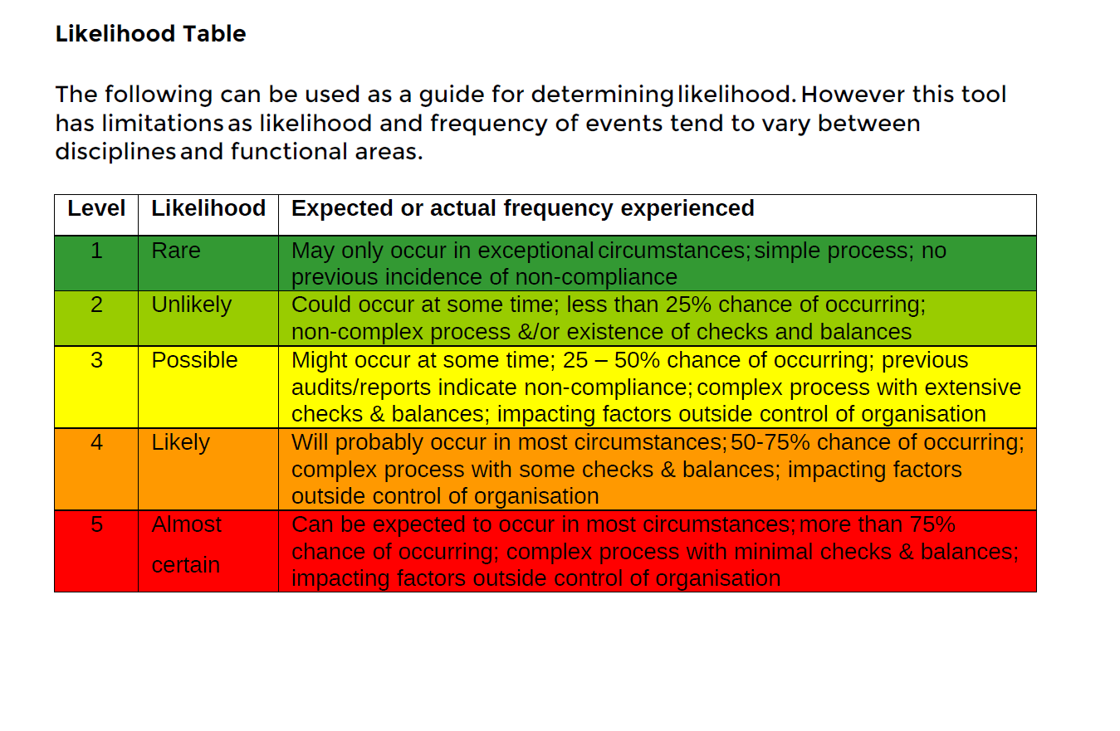

Slide 30
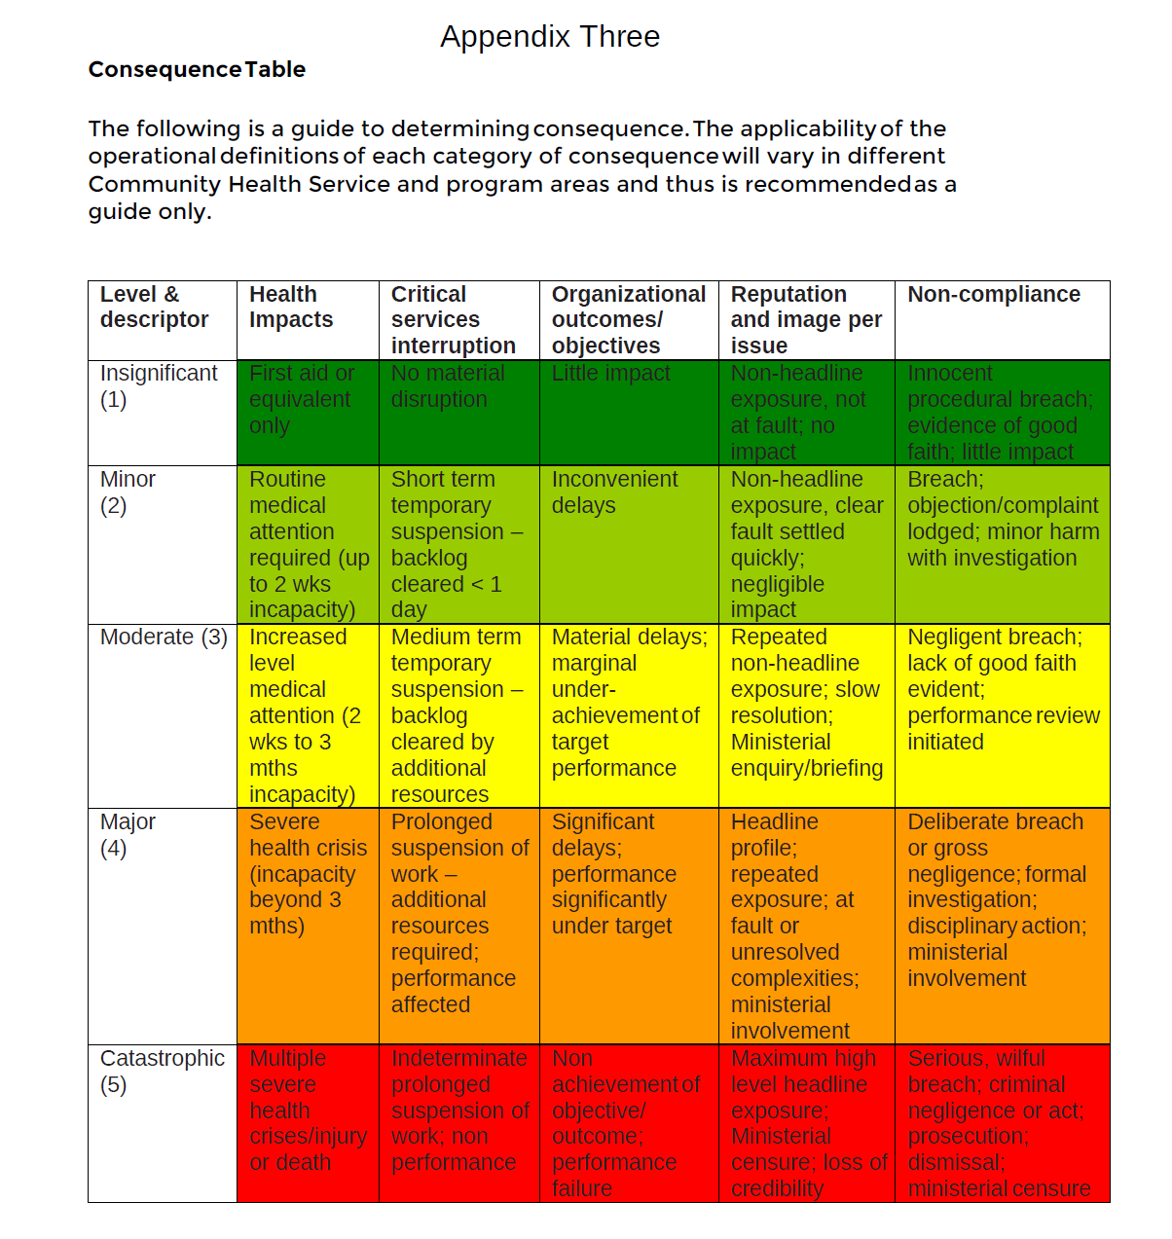

Slide 31
High
Medium
Low
Extreme

Slide 32
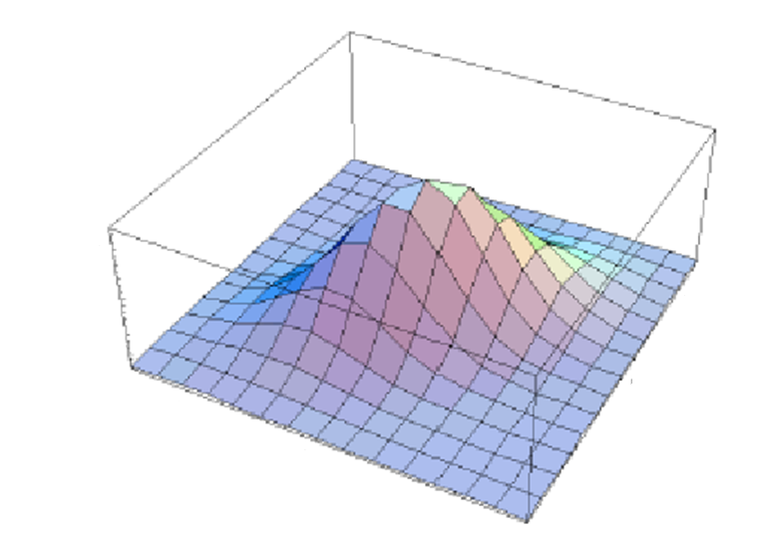
Normal Distribution of Risk, Consequence and likelihood
5
Risk
5
0
5
Likelihood
Consequence
0
0

Slide 33
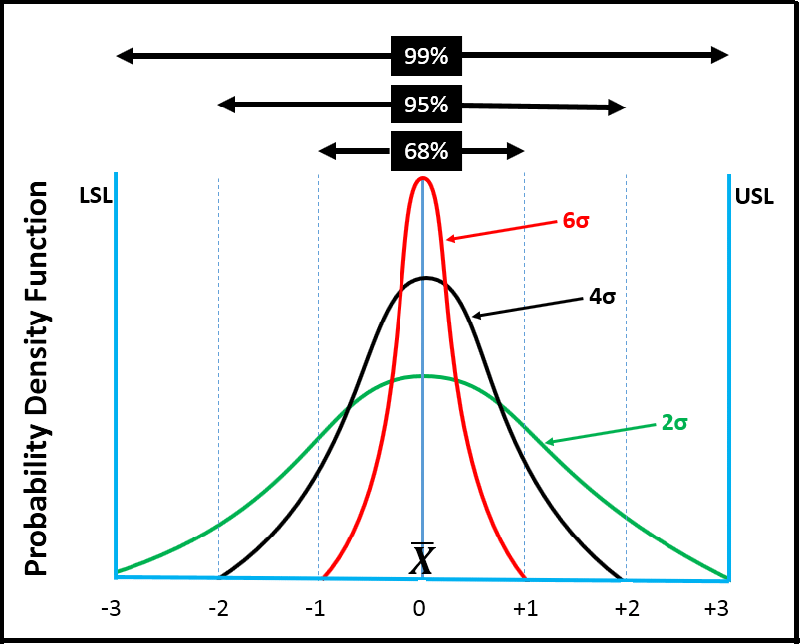
Variation
A change or slight difference in condition, amount, or level, typically within certain limits.
mass noun ‘the figures showed marked variation from year to year’
Mathematics A change in the value of a function due to small changes in the values of its argument or arguments.

Slide 34
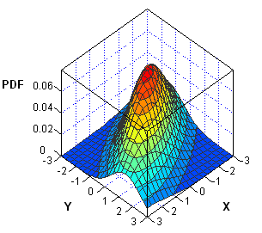
Skewed Distribution of Risk, Consequence and likelihood
5
Risk
0
5
5
Consequence
Likelihood
0
0

Slide 35
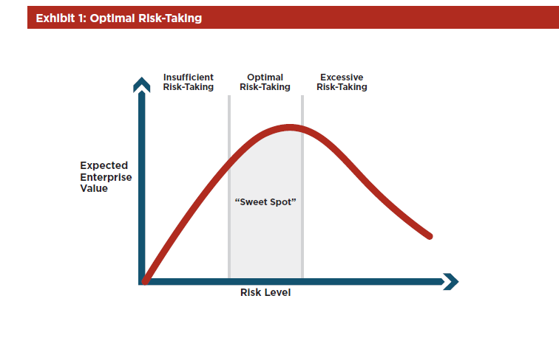

Slide 36
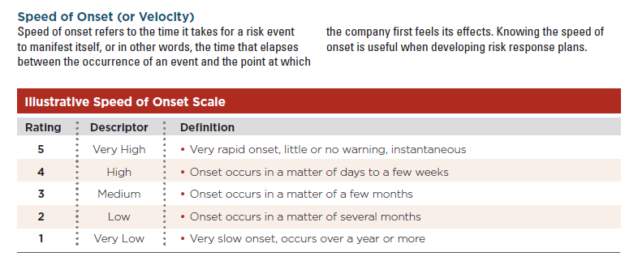

Slide 37
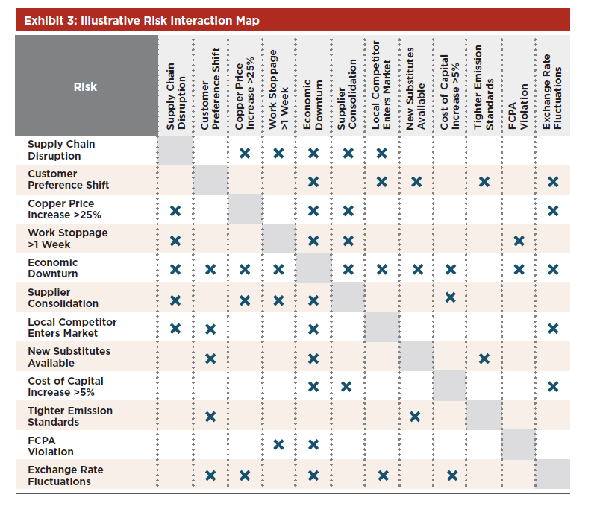

Slide 38
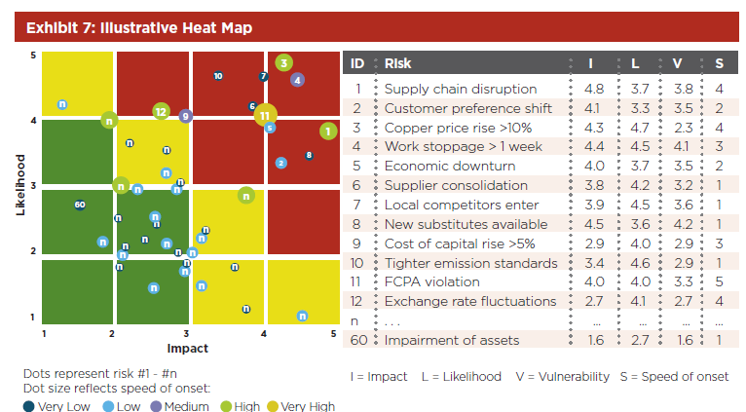

Slide 39
Threat Model
Capability
Low
High
High
Intent
Low
Malicious Actor
Low Intent
Low Capability
Malicious Actor
Medium Intent
Medium Capability
Malicious Actor
High Intent
High Capability

Slide 40
Vulnerability Model
Vulnerability
Low
High
Protected system
High system integrity
Extensive monitoring
Regular reviews
Unprotected system
Low visibility
Low Capability
Minimal review

Slide 41
Harm Model
Low
Capability
High
High
Intent
Low Likelihood
of
Harm
High Likelihood
of
Harm
Low
Vulnerability
Low
High

